Slide 1
Steps for developing a case study
Define the scope of the Study:
Identify policy issues and questions to be addressed and design the case study accordingly
Map schematically the system:
Identify natural resources, energy carriers and technologies that are used and those that may be used in the country (build a ‘Reference Energy System’)
Define scenarios:
Identify sets of assumptions and prepare the corresponding scenarios to be analyzed

Slide 2
1. Define the scope of the study
The scope of the study depends on the energy policy question that you want to address, e.g.:
What policy interventions are necessary to ensure adequate, reliable, and affordable energy supplies?
What needs to be done and what will be the costs to supply modern energy sources to remote areas?
What if environmental regulations are made more stringent?
What needs to be done to increase the share of renewable technologies?
Should electricity import be allowed?
Should the existing nuclear facilities be closed down?
Can energy conservation program help in reducing cost of energy supply?

Slide 3
2. Map schematically the system
Given the scope of the study, what is it important to analyse?
What technologies could play a role under different demand projections?
Are there sub-national, national or regional dimensions which have to be taken into account?
Are there boundaries and limitations in the energy system?
One or more/all energy forms/fuels?
One part of complete energy chain?
…
Do not over complicate! Bigger model usually means more problems!

Slide 4
2. Map schematically the system
To model the initial conditions of the system
To identify the existing competitions in the system
You may represent the energy system in an aggregated fashion. E.g.:
Aggregate transmission and distribution networks
Aggregate some facilities with common features: e.g. one technology to represent a set of existing coal-power plants

Slide 5
2. Map schematically the system
Identify any possible alternatives in the supply system that could be introduced to help meet the policy objectives and targets
Identification of new technologies e.g. combined cycle power plant, e.g., concentrated solar power
Identification of new energy supply sources e.g. coal or gas import options
Identification of "future" technologies

Slide 6
2. Map schematically the system
Identify physical / technical constraints in exploitation of each energy source and technology
Identify limits for each source in terms of quantity and time of supply

Slide 7
2. Map schematically the system
Based on the above, design a Reference Energy System (RES)
RES is a simplified and aggregated graphical representation of the real energy system under analysis;
RES covers not just the present configuration of the energy system, but also possible development paths;
It shows all existing and potential new energy supply chains, from primary energy resources to final demand;
The level of simplification depends on issues to be analysed and data availability;
RES should be a minimum representation of reality needed to answer the policy questions to be addressed;

Slide 8
2. Map schematically the system
RES consists of:
Energy Levels
Resources, Primary, Secondary,..., Final,…
(extracted from resources, processed, converted, transmitted, distributed, …)
Energy carriers / commodities
Coal, oil, gas, wood, nuclear fuel, electricity, heat,…
Technologies
Which extract, process, convert energy from one to another form or to energy service, transmit and distribute

Slide 9
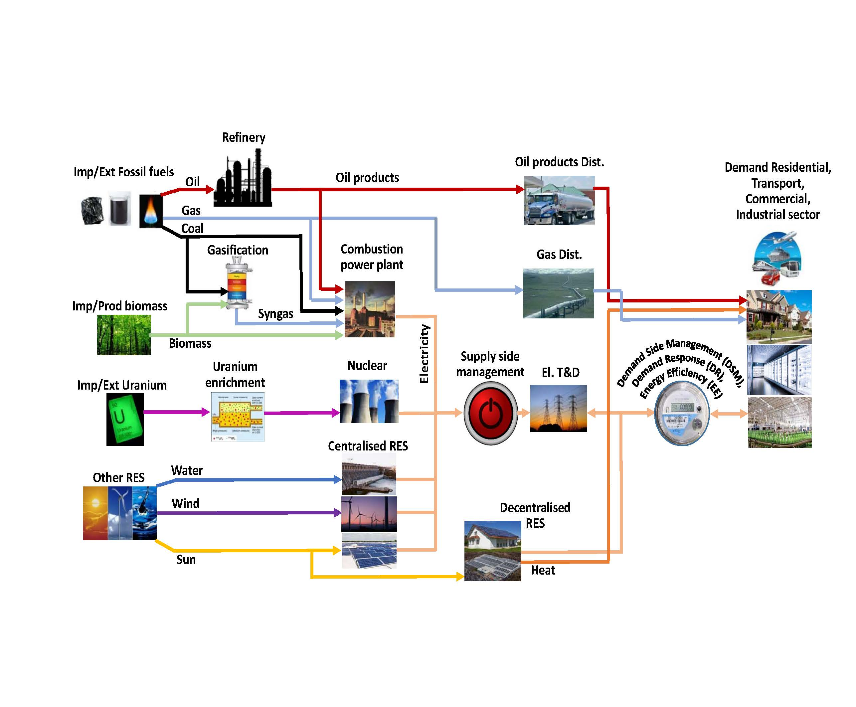
2. Map schematically the system

Slide 10
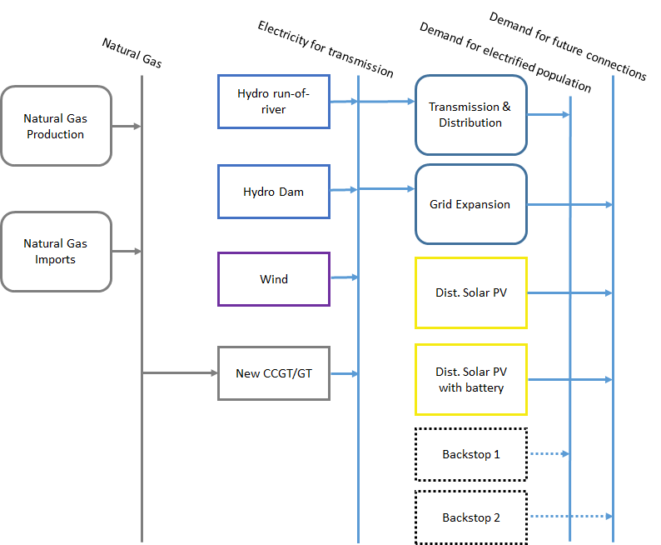
2. Map schematically the system
Resources
Primary
Secondary
Final

Slide 11
3. Define scenarios
Scenario - not prediction, but description of possible future development:
Consistent set of assumptions (reflecting policies and constraints)
Expert judgment/informed guesses how the future may evolve (prices, technologies…)
Model results
Set of alternative scenarios:
Provide alternative development paths
Assist in understanding possible future developments of complex systems
Helps identify robust investment choices and policies

Slide 12
3. Define scenarios
Specify:
Available technologies
Development of technological parameters (e.g., investment costs, unit size, construction time, efficiency, O&M costs, emission factors, limitation etc.)
Trends of resource availability & costs; import and export prices for fuel
Policy constraints (fixed investment plan, environmental regulation, other socio-economic policies)
Based on:
Literature
Concrete plans and policies
Expert judgments / informed guesses / experience from historic developments

Slide 13
3. Define scenarios
Examples of scenarios based on policy constraints:
Introducing nuclear beyond 2030
Achieving given share of electricity produced from renewable technologies
Limiting air emissions
Limiting import dependency
…

Slide 14
General recommendations
Keep focus on objectives (easy to forget)
Consider available human resources and data availability
Define system boundaries and system details accordingly
Keep model as simple as possible
Build gradually
Introduce constraints step by step
Interpret the results
Prepare recommendations

Slide 15
General recommendations
High disaggregation in certain parts of the system can help in analyzing some policy options
The remaining supply system can be aggregated. E.g.:
High disaggregation at the final and useful levels in order to analyze energy conservation programs
High disaggregation at the secondary level to assess the role of different generation options

Slide 16
General recommendations
When preparing your study…
Review existing studies
Review socio-economic development plans
Review sectorial policy/plan documents (coal, oil, gas, and renewables …)
Review studies on resource assessments (e.g., technical potential vs. economic potential)
Review environmental regulations
Collect reliable cost estimates

Slide 17
General recommendations
Prepare summary of the existing energy supply system
Prepare a base scenario
A scenario based on highly likely development path of the energy supply system – often named "Business-as-Usual"
Based on inputs from sub-sectors of energy sector e.g. power sector development plan, gas/oil sector development plan…

